Slide 1


AIDA
Manuel d'utilisation
https://espace.cern.ch/aida
Vincent Boudry
SOCLE 2009
10/11/2009
INSTN, CEA Saclay

Slide 2
Advanced european Infrastructures and Detectors at Accelerators
† DevDet (Appel FP7 2008) † .... RIP
  ⇒ EUDET étendu à ILC/CLIC, sLHC, SuperB, neutrinos
    SLHC (luminosity-upgraded LHC),
    future Linear Colliders (ILC and CLIC),
    future accelerator-driven neutrino facilities
    or future B-physics facilities (e.g. Super-B)
The AIDA project is
  coordinated by the Restricted ECFA Coordination Group for Detector R&D in FP7 programs
  responds to the FP7-INFRASTRUCTURES-2010-1 call from the European Commission.
AIDA addresses infrastructures required for the development of detectors for future particle physics experiments.
In line with the European strategy for particle physics
AIDA targets user communities preparing experiments at a number of key potential future accelerators:

Slide 3
Vue d'ensemble
The infrastructures covered by the AIDA project are key facilities required for an efficient development of the future experiments, such as:
  test beam infrastructures (at CERN and DESY),
  specialised equipment irradiation facilities (in several European countries),
  common software tools,
  common microelectronics tools
  and engineering coordination offices.
The requests to EU concern improvements to existing infrastructures
Submission deadline is 03/12/2009.
selection: April/May + 2-3m Negotiations + 3m formal agreem^{t}
finalisation by end 2010
A 4 year project (3 years if negotiated)

Slide 4
Structure
The project is structured around 9 work packages :
  management,
  coordination/networking, (COORD)
It is managed through:
  A set of coordination contacts
  A set of national contacts
Full partner and third party, associate
  Full /3rd limit set at ~ 50 k€ (~1 yr PD)
    France: FP = CNRS & CEA
    Univ. as 3rd party → ⚠ uniq^{t} engagement de pers. permanent CNRS ⚠
  Associate = only travel money
  transnational access, (TA)
  joint research activities (RTD)
  A set of WP coordinators
    2 per WP of different origins (ILC/Other)
    A set of task coordinators

Slide 5
Coordinators & Contacts
Coordinators
National Contacts
Switzerland Pohl Martin
Germany Feld Lutz
Spain Lacasta Carlos + Vila Ivan
Portugal Bordalo Paula
Netherlands Koffeman Els
Israel Mikenberg Giora
Czech Republic Vrba Vaclav
Poland Zarnecki Filip + Idzik Marek
Austria Krammer Manfred
Finland Osterberg Kenneth + Tuominen Eija
Hungary Bencze Gyorgy
Sweden Brenner Richard
Norway Stapnes Steinar
Denmark Hansen Peter
Italy Meroni Chiara
UK Long Ken
Belgium de Lentdecker Gilles
Bulgaria Stamenov Jordan
France Boudry Vincent + Colas Paul
Greece Gazis Evangelos + Alexopoulos Theodoros
Malta Sammut Nicholas
Slovenia Mikuz Marko
Slovakia PiknaMiroslav
Finland Härkönen Jaakko
Bulgaria Iaydjiev Plamen Stoianov
T. Behnke DESY
C. Brandt CERN
K. Büsser DESY
M. Capeans CERN
F. Forti CERN
K. Kahle CERN
L. Linssen CERN
L. Serin CNRS Chair.
C. Sheperd RL
P. Soler Jermyn Glasgow
S. Stapnes CERN
S. Stavrev CERN
H. Taureg CERN
K. Ross CERN

Slide 6
Work packages
WP | Title | Contact | Fonds
1 | Project management and coordination | F. Stavrev | 500k€
2 | Development of software common tools | F. Gäde, P. Mato | 1100k€
3 | Micro electronics and detector electronics integration | H-G. Moser, V. Re | 1100k€
4 | Relation with industry | P. Sharp, R. Stapnes | 300k€
5 | Transnational access to DESY | I. Gregor | 100k€
6 | Transnational access to CERN | H. Taureg | 150k€
7 | Transnational access to EU irradiation facilities | M. Mikuz | 450k€
8 | Improvement and equipment of irradiation and beam lines | H. Taureg, E. Gschwendtner | 3000k€
9 | Advanced infrastructures for detector R&D | M. Vos, H. Videau | 3000k€
 |  |  | ~10 M€
Montants uniquement indicatifs → changements possibles d'ici le 26 novembre
10 M€ ~ correspondants à ~ 33 M€ total (⊃ Overhead)
soit ≥ ~10 M€ engagés (10+10)*160% ~ 30M€

Slide 7
WP2: Common SW tools
Activity type COORD
Objectives
Task1: Coordination of Work package
- monitor the progress of the work in the work package
- coordinate and schedule the execution of the tasks and subtasks
- prepare progress reports – internal and on deliverables
Task2: Development of a geometry toolkit
- allow the description of complex geometrical shapes, materials an sensitive detectors
- provide interfaces to full simulation programs (Geant4), fast simulations,
visualization tools and reconstruction algorithms
- allow for the misalignment of detector components
- provide an interface to calibration constants and conditions data
Task3: Development of generic reconstruction tools
- tracking toolkit based on best practice tracking and pattern recognition algorithms
- provide alignment tools
- allow for pile up of hadronic events
- calorimeter reconstruction toolkit for highly granular calorimeters based on Particle Flow algorithms
Participants: CERN, DESY, HEPY-Vienna, LLR, UCAM, RAL, UGLA
Contained now also some sLHC.
WP and partner list mainly fixed.

Slide 8
WP3: Network for micro-electronics and interconnection technology
Activity type COORD
Objectives:
the main objective of the task is to establish a network of groups working collaboratively
on advanced semiconductor technologies and high density interconnection processes
for applications in High Energy Physics.
Task1: Coordination of Work package
Task 2: 3D Interconnection:
• Creation and coordination of a framework to make 3D interconnection technology available
for HEP detectors
• Organisation of dedicated fabrication of sensors and electronics optimized for 3D interconnection
• Construction of demonstrator detectors using 3D technology to access this technology
Task 3: Shareable IP Blocks for HEP
• Creation and coordination of a framework for the design of low and medium complexity
microelectronics libraries and blocks in advanced submicron technologies to be made
available to the community of users in HEP
• Organization of the design and qualification of a set of blocks using selected and qualified technologies
• Distribution and documentation of the library of functional blocks
• Organization of regular Microelectronics Users Group meetings to exchange information,
plan and coordinate actions related to the creation of a shared library of macro blocks.
Participants: AGH, CERN, CEA, CNRS, CPAN, INFN, MPG
almost ready, might need tuning on budget

Slide 9
WP4: Relation with industry
Activity type COORD
Objectives
Overall goal: address for the “our” projects – sLHC, ILC/CLIC, Neutrino Det., SuperB
• Technology needs, specifications, trends in several area (5-10 years perspective)
• Interactions with industry in development phase and during (large scale) constructions
phase
• Transfer to industry, industry related spin-off, and collaboration and co-development with
other fields where this is relevant.
Create WEB overview and report covering in a matrix key technologies and specifications
(x-axis) versus the four projects mentioned (y-axis).
Industry can link to these nodes describing their capacities.
To be maintained longer term by the CERN TTnet.
Participants: STFC, Oslo, CERN, Helsinki, INFN, CNRS, Athens, ..
WP and partner list mainly fixed.

Slide 10
WP5, 6, 7: Transnational Access
Essentially an amount of money to help people in needs in accessing to
WP5: DESY facilities
ready
WP6: CERN facilities
ready
WP7: EU irradiation facilities
Need to write WP and budget…
Will be discussed with EU coordinators at Brussels
next Thursday 12/11/09

Slide 11
WP8: Improvement and equipment of irradiation and beam lines
Objectives
Task1: Coordination of Work package
Task 2: Test beams at CERN and Frascati
• At CERN: Enlarge particle choice (K0), improve particle identification
Provide LC/CLIC like spill structure
• At Frascati: characterize BTF beam line for electrons and photons
provide and install permanent control and monitoring system for beam position,
width and energy in the BTF beam line
Task 3: Upgrade of proton and neutron irradiation facilities at CERN
• Design splitter magnet
• Equip and test splitter magnet
• Design and test cooling infrastructure for electronics tests
Task 4: Qualification of components and common database
• Review experience from LHC
• Develop common data base for irradiation test results
• Qualify materials and components of detector systems
• Populate and maintain the common database
• Disseminate and publish irradiation results
Task5: Common DAQ infrastructure
Activity type RTD
WP text is mostly ready. Partner list to be checked
Preliminary budget existing
Participants: CERN, LNF, UK univ., DESY, CNRS, ULB, LUND, UNIGE

Slide 12
WP9: Advanced infrastructures for detector R&D
Objectives
Task1: Coordination of Work package
Task 2: Gas detector facilities (P. Colas, K. Desch)
under discussion
Task 3: Precision pixel infrastructure (M. Winter +)
under discussion
Task 4: Granular calorimeter studies infrastructure (F. Sefkow, H.V.)
A global test beam infrastructure, containing silicon tracker, lumi calorimeter, el-mgn and hadron for specific tests and understanding of the simulation and the particle flow
Under development
Activity type RTD
Participants: many
Still the most difficult WP.
WP text not yet ready.
(too ?) large partner list to finalized
Budget still not done.
Request by some Institutes on Si Strips community
to modify the tasks…

Slide 13
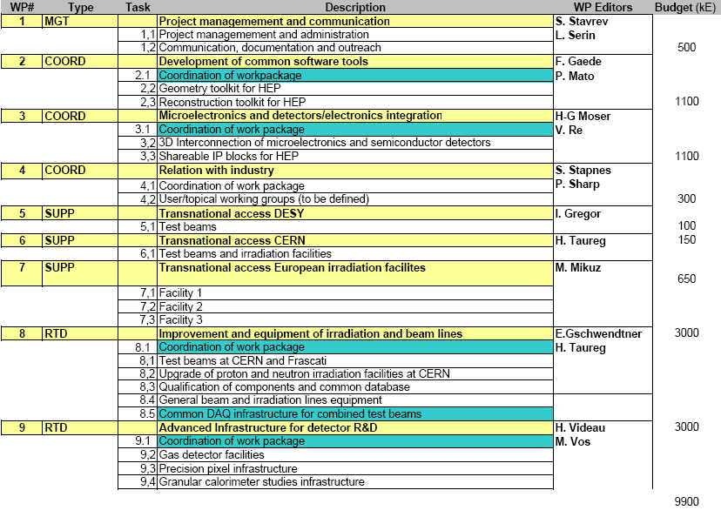

État des lieux
Pas mal de WP's (WP9) pas encore
prêts & récemment changés
Meeting pour les contacts nationaux le 9 novembre (hier)
  Encore beaucoup d'incertitude
Prochaines étapes:
  October 6th : National contact meeting
  October 26th : Contents of WP finalized,
  first draft of WP text & partners list
  Preliminary budget breakdown for each WP
  November 9th :
  Finalized list of partner in each WP Iteration on budget sharing National Contact texts
  November 23th : All WP contributions finalized
  December 1st : Proposal submission
Beaucoup de travail encore en ≤1mois

Slide 14
Pendant ce temps, en France....
A remplir pour le 16 novembre
Country:
Short name of participant: |  | Full name of participant:
Description of participant: DESCRIBE CONSORTIUM AND INSTITUTE SKILLS TO PARTIPATE TO AIDA WP. IF SINGLE INSTITUTE SHOULD FIT IN 10 LINES IF CONSORTIUM ~5 LINES PER INSTITUTE
Tasks in AIDA TASK NUMBER IN EACH WP.
Short CV for the key persons: MAX ONE CV PER INSTITUTE + NATIONAL CONTACT 4 LINES / CV

Slide 15
Remboursements
Taux de remboursement MAXIMUM par activité
  NA are limited to (direct cost)* 1.07
  JRA are limited to 75 % of
  (direct cost and full overhead) rate
  This is our choice in AIDA
  to fund JRA and NA is same way
  (direct + indirect costs)*0.3 (have to be < max allowed)
Overhead Personel & Materiels: CNRS = 60% & 60%
CEA = 60% & 0%
Activity | Rate
MGT (WP1) | < 50 %
NA/COORD (WP 2,3,4) | 30 %
TA (WP 5,6,7) | ≥ 75 %
JRA(RTD) (WP 8,9) | 30 %

Slide 16
Remboursement (2)
Exemples (CNRS à 60/60)
  Normal: ensemble des dépenses directes du projet (Mat, pers perm, missions) → 48% [160%*30%] pris en charge
  Inverse: pour obtenir 10k€,
  il faut un total de 33k€ (10/30%) (toutes dépenses + OH)
  soit 20.6k€ (33k€/160%) de dépenses directes,
  partagés en 10.6k€ de coût directs engagés (personnel permanent)
  et les 10.0k€ obtenus de l'Europe (pour les CDD, missions, etc.)
  Equivalent: 1 ppm post-doc (~5k€) → engagement en salaire de personnel permanent de 1.08 (52%/48%) fois celui du post-doc.
La limite est très vite atteinte avec du personnel permanent
  → limiter au personnel CNRS
  → limiter au nécessaire ( ⚠ feuilles de temps mensuelle ⚠)
ATTENTION:
  Aux ponctions universaires & administratives → V DR pour les taux (0–15%)
  Achat de matériel non-amortis à la fin du contrat (rmbt quote-part)

Slide 17
Bref...
À vos calculettes
  la période des négociations va commencer
Vous allez recevoir des documents à remplir
  CV
  Liste des personnels & salaires correspondants
N'hésitez pas à me contacter en cas de doute
  et votre DR en cas de doute sur les chiffres (salaires, prélèvements)
Cédric Bosaro de la cellule Europe de l'IN2P3.
https://espace.cern.ch/aida/default.aspx
BON COURAGE...

